Slide 1
Module 2
Long Report
Learning Objective:
When you complete this module, you will be able to create well designed long reports, whether working independently or with others, and to correctly document the sources of your information.

Slide 2
Module 2 Group Project (Long Report)
Timeline
Week 09 – Grouping students (3 in each group)
Introduce the task
and the components of a long report.
Week 10 – Project title submission by group leaders
Weeks10, 11, 12,13 – Students gather relevant info and prepare a long report .
Week 14 – Students must submit the report.
Week 15 – Presentation (no report, no
presentation)

Slide 3
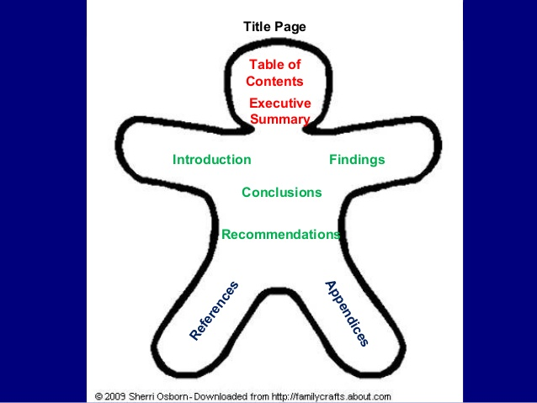
Parts of a Long Report

Slide 4
Long Reports
In business, industry, and the professions, important decisions are made every day. Some concern routine matters, and others are more complicated, involving considerable risk and expense. This is where the long report comes into play. This module discusses how to prepare such a report, explaining its formatting components, the dynamics of group-written reports, and some standard procedures for documenting sources.

Slide 5
Format
Transmittal Document
Title Page
Abstract (Summary)
Table of Contents
List of Illustrations (optional)
Glossary (optional)
Text with visuals (The report)
References

Slide 6
Transmittal Document
The transmittal document is prepared according to standard memo format. It accompanies a long report conveying it from whoever wrote it to whoever requested it. The transmittal document says, in effect, “Here’s is the report you wanted”, and very briefly summarizes its content.
Often the transmittal document serves as a “cover sheet”, although sometimes it is positioned immediately after the title page of the report.

Slide 7
Title page
This page includes the title itself, the name(s) of whoever prepared the report, the name(s) of whoever requested it, the name of the company or organization involved, and the date.
In an academic context the title page includes the title, the name(s) of the student author(s) and the instructor who assigned the report, the course name (along with the course code and section number), the college, and the date.

Slide 8
Abstract
An abstract is sometimes called an executive summary. It is simply a brief synopsis – a greatly abbreviated version of the report. An effective abstract captures the essence of the report, including its major findings and recommendations. In the workplace the abstract assists those who may not have the time to read the entire report but need to know what it says. The abstract should be formatted as one long paragraph.

Slide 9
Table of Contents
The table of contents for a long report clearly shows each numbered section of the report, along with its title and the page on which it appears. Many also show subdivisions within sections.
When fine-tuning a report before submitting it, check to ensure that the section numbers, titles, and the page numbers used in the table of contents are consistent with those in the report itself.

Slide 10
List of Illustrations
This lists tables, graphs, charts, and all other visuals appearing in the report-each numbered and titled – and their page numbers.

Slide 11
Glossary
A “mini-dictionary” that defines all potentially unfamiliar words, expressions, or symbols in your report.
Not all reports need a glossary. It depends on the topic and the intended audience.

Slide 12
Text with Visuals
Every long report includes an introduction, findings, and a conclusion (with recommendations, if any).
The introduction provides an overview of the report, identifying its purpose and scope, and explaining the procedures used and the context in which it was written. The findings part states what you have investigated and found. The conclusion summarizes the main points in the report and lists recommendations, if any.
Integrate visuals into the text.

Slide 13
References
This is a list of sources of information used in the report.
Documentation is the technical term used for the procedure whereby writers identify the sources of their information.
Documentation is necessary to avoid plagiarism ( the use of someone else’s work without proper acknowledgment) or
“passing off another person’s ideas as your own”

Slide 14
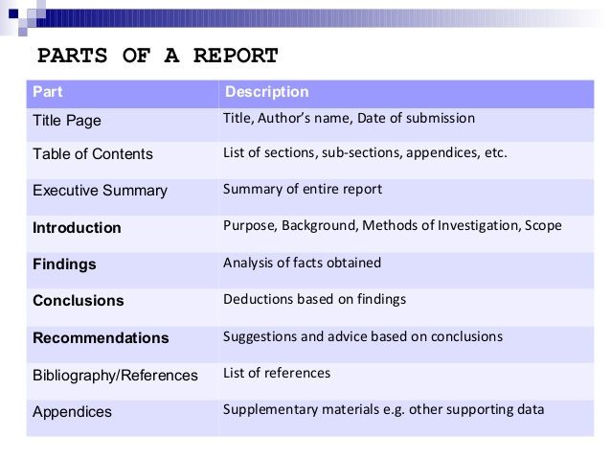
PARTS OF A LONG REPORT

Slide 15
Evaluating a Long Report
An effective long report
is accompanied by a transmittal document
includes certain components
Title page
Abstract
Table of Contents
List of illustrations
Glossary

Slide 16
Evaluating a Long Report
- is organized into sections numbered and titled in conformity with the table of contents, covering the subject fully in an orderly way.
- is clear, accurate, and sufficiently detailed to satisfy the needs of the intended audience.
uses plain, simple language.
maintains an appropriate tone, neither too formal nor too conversational.
employs effective visuals
includes full documentation
contains no typos or mechanical errors in spelling, capitalization, punctuation, or grammar.

Slide 17
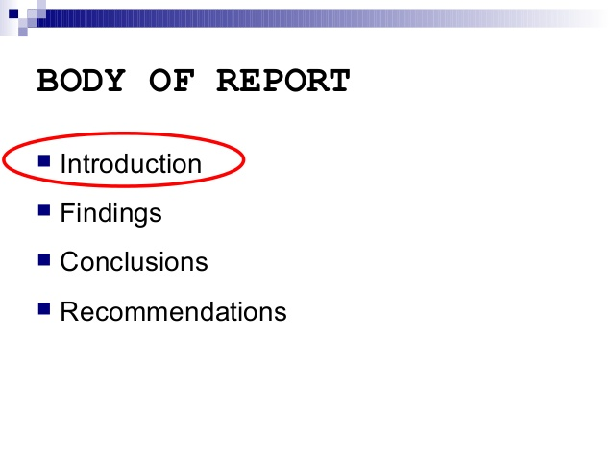
BODY OF A LONG REPORT

Slide 18
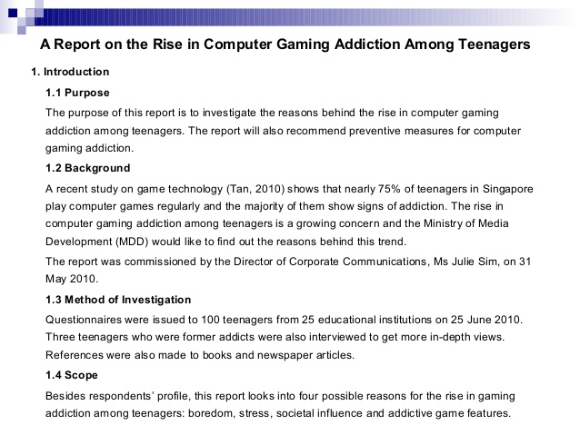
A sample introduction to a long report

Slide 19
Guidelines for Writing the Abstract
Write the abstract last, after writing the entire report.
Center the word ABSTRACT at the top of the page and underline it.
Content/Organization – Make sure these five main points are covered in the abstract
- principal objectives and the scope of the work done
- the methodology employed
- the results
- the conclusions
- the recommendations

Slide 20
Guidelines for Writing the Abstract
Do not exceed 250 words
Do not cite references to the literature, that is, references to sections, figures, tables, bibliographic information, etc. in the abstract.
Do not include historical information.
The abstract may contain standard abbreviations and numerals.
The abstract is self-contained, that is, it is a complete report in miniature. The program committees of many engineering conferences will often use abstracts as the sole basis for accepting papers to be presented.
The abstract should never give any information or conclusion that is not stated in the report.

Slide 21
Abstract Writing Means
What did you do? Where? When?
Why did you do?
How did you do?
What did you find?
What did you conclude? Recommendations?
GOOD LUCK WITH YOUR PROJECT WORK !

Slide 22
Schedule
Week 09 – Decide topic and distribute work among members
Week 10 – Start research. Make rough draft by weekend.
Week 11 – Group members meet and discuss about the draft.
Week 12 – Meet again to look at the second draft with visuals
Week 13 – Organize. Share work on front page matters and
references. Visit writing center for corrections.
Week 14 – Final draft. Submission on 07 April 2019
Week 15 – Presentation on 14 April 2019

Slide 23
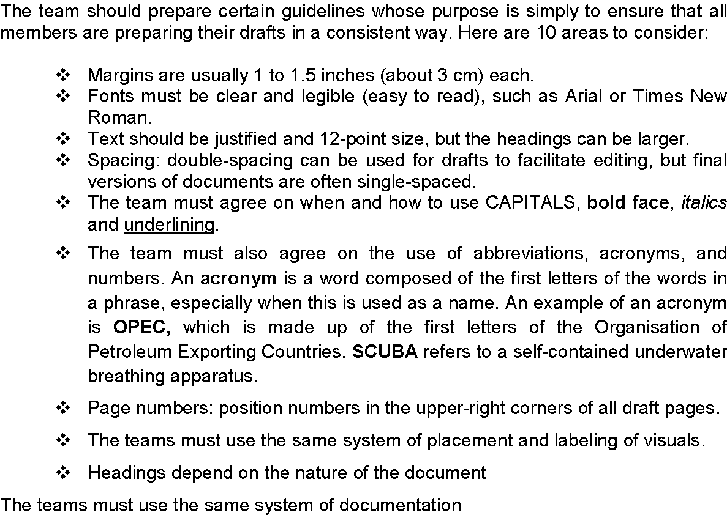
The Team (Only three members in a team)

Slide 24
The Team Work
There are three ways to handle the writing of a long report:
The whole team writes the report collectively, and then the editor revises the draft and submits it to the group for final approval and additional revisions. It is the most truly collaborative, but it is extremely difficult and time consuming, requiring uncommon harmony within the group.
One person writes the entire report, and then the group, led by the editor, revises it collectively. This way is preferable, but it places too great a burden on one writer.
Each team member writes one part of the report individually, and then the editor revises each part and submits the complete draft to the whole group for the final approval or additional revisions. This is the most common and certainly the best way, provided the editor seeks clarification from individuals whenever necessary.
[Therefore, let the students write a long report using this common method.]

Slide 25
GPW Tasks
Progress in learning ENG 201 Technical Report
writing course.
Progress in repairing a CNC machine in the
mechanical engineering workshop.
Progress in beautifying YIC campus as part of socially useful and productive work program.
Progress in learning a technical subject titled ‘Mechatronics’

Slide 26
GPW Tasks
Bachelor degree students’ progress in doing senior design project (SDP) at YIC.
Progress in manufacturing equipment needed in YIC mechanical engineering labs.
Progress in testing all equipment in the chemical engineering workshop at YIC.
Progress in doing some productive work useful for Yanbu community.

Slide 27
GPW Tasks
ENG 201 section 55 students’ progress in doing their group project work.
Progress in gathering information about a technical subject named ‘robotics’.
Progress in helping some people in a village to establish a library and reading room.
Progress in removing the impurities in Yanbu Lake in Yanbu Industrial City.

Slide 28
GPW Tasks
Progress in training school boys in Yanbu to communicate in English language.
Progress in designing a website for ICT department at YUC.
Progress in preparing for the final examination of Geomatics Engineering Technology in 2019.
Progress in examining all electrical circuits and control systems in EEET department at YIC.

Slide 29
Page Design
Margin 1 inch / 1.5 inch
Font type Times New Roman/Arial
Font size 12 (14 for titles)
Picture size quarter page
Page number top right corner
Heading number upper case Roman numerals
( I, II, III, IV………)
Sub-heading number lower case Roman numerals (i, ii, iii,)
Paragraphing one line space
Spacing single-spaced
(drafts can be double-spaced to facilitate editing)
Typing black ink

